Slide 1




Connecting to various data sources in power bi

Slide 2
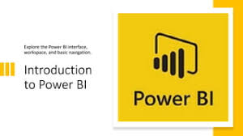
Introduction
Power BI is a powerful business analytics tool that enables organizations to visualize their data and share insights across their teams. One of its key strengths lies in its ability to connect to a wide variety of data sources, ranging from traditional databases like SQL Server to cloud services such as SharePoint and Google Analytics. By seamlessly integrating these diverse data sources, Power BI allows users to create comprehensive reports and dashboards, enhancing decision-making and driving business intelligence. This presentation will explore the different types of data sources that can be connected to Power BI, the steps involved in establishing these connections, and best practices for effectively managing and utilizing the data.

Slide 3
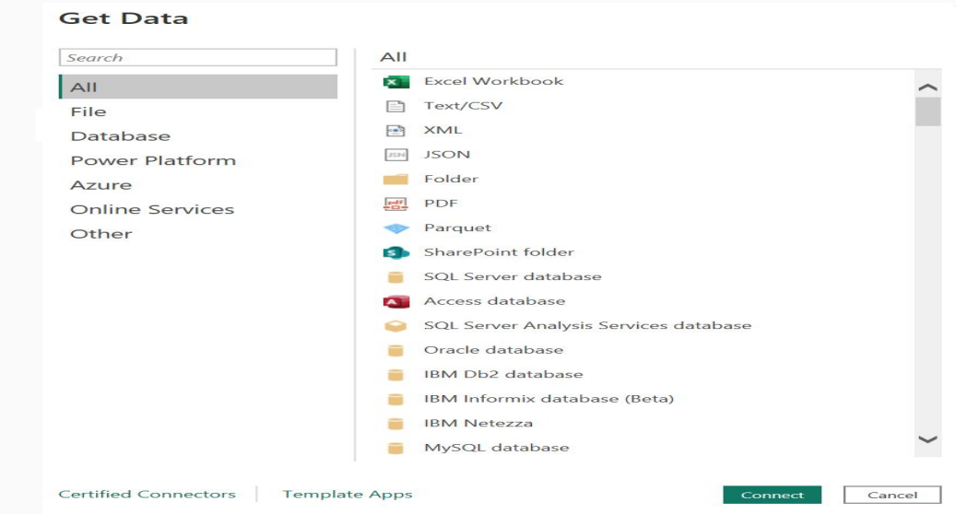
Types of Data Sources On-Premises Data Sources: SQL Server Excel files Access databases Cloud-Based Data Sources: Azure SQL Database SharePoint Online Google Analytics Web and API Sources: REST APIs Web scraping Others: CSV, JSON files DirectQuery and Import options

Slide 4
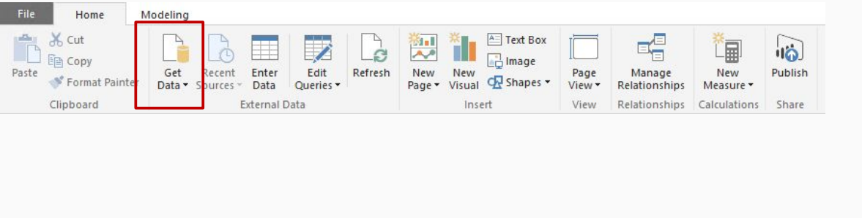
Connecting to Data Sources
Overview of the connection process
Steps to connect:
Open Power BI Desktop
Select "Get Data"
Choose data source type
Enter connection details
Load or transform data

Slide 5
Import vs. Direct Query
Import Mode:
Data is imported into Power BI.
Benefits: Fast performance, rich modeling
Direct Query Mode:
Queries are sent to the data source in real time.
Benefits: Always up-to-date data, no need for data refresh.

Slide 6
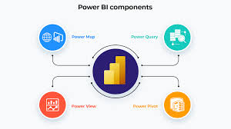
Data Transformation and Modelling
Power Query is a data transformation and data preparation engine.
● Using Power Query, you can perform the extract, transform, and load (ETL) processing of data.
● Power Query feature allows you to do sophisticated data transformations such as: Removing any extraneous columns, rows, or blanks, Conversions of data types – text, numbers, and dates, Columns can be split or merged, New computed columns are being added, Data aggregation or summarization, among other things.

Slide 7

Data Cleaning and Transformation with Power BI Desktop
Data from different sources often requires cleaning and transformation for effective analysis and visualization.
● Power BI Desktop provides the necessary tools to clean and transform data. The Challenge of Data Integration
● Data from various systems may have different formats and structures.
● Example: Customer details in CRM, IoT data in Azure IoT Hub.
● Cleaning and transforming data is crucial to integrate and analyze it effectively

Slide 8
Conclusion
In conclusion, connecting to various data sources in Power BI is not only essential for gaining a holistic view of your organization’s data but also for unlocking the full potential of your analytics capabilities. By understanding the different connection options and best practices, users can ensure that their reports and dashboards are both accurate and insightful. As data continues to grow in volume and complexity, leveraging Power BI's connectivity will empower organizations to make informed decisions, foster collaboration, and drive performance across all levels. Embracing these tools will undoubtedly lead to more data-driven strategies and a competitive edge in today’s data-centric landscape.

Slide 9
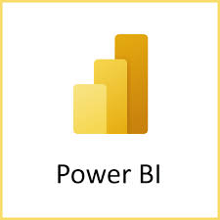
THANKYOU
If you have any questions?
thahliyamist@gmail.com

